Slide 1

Three Minute Technical Talk
By Ryan J. Skelly

Slide 2
Overview (What Topics will we focus on)
What is SpaceX?
Who Benefits From SpaceX?
What Services does SpaceX provide?
How does SpaceX differ from related/existing technology?

Slide 3
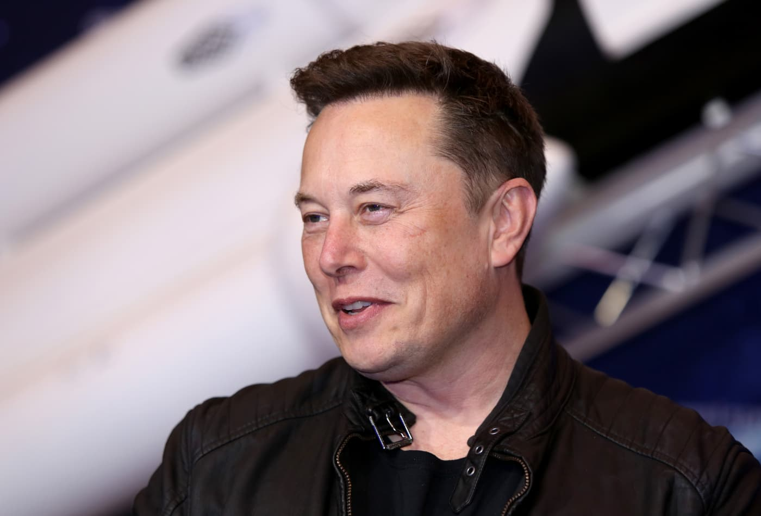
1) What is SpaceX?
Space Exploration Technologies Corp. is an
aerospace manufacturer and space transportation
services company, founded in 2002 by Elon Musk.
The company produces spacecraft for both low
orbit(Satellites, frequent trips to the ISS) and
interplanetary travel.
Leading manufacturer of Space travel technology in 2021 with 111 total launches and 74 successful landings. StarLink Global Wireless program has 1021 satellites in our orbit.

Slide 4
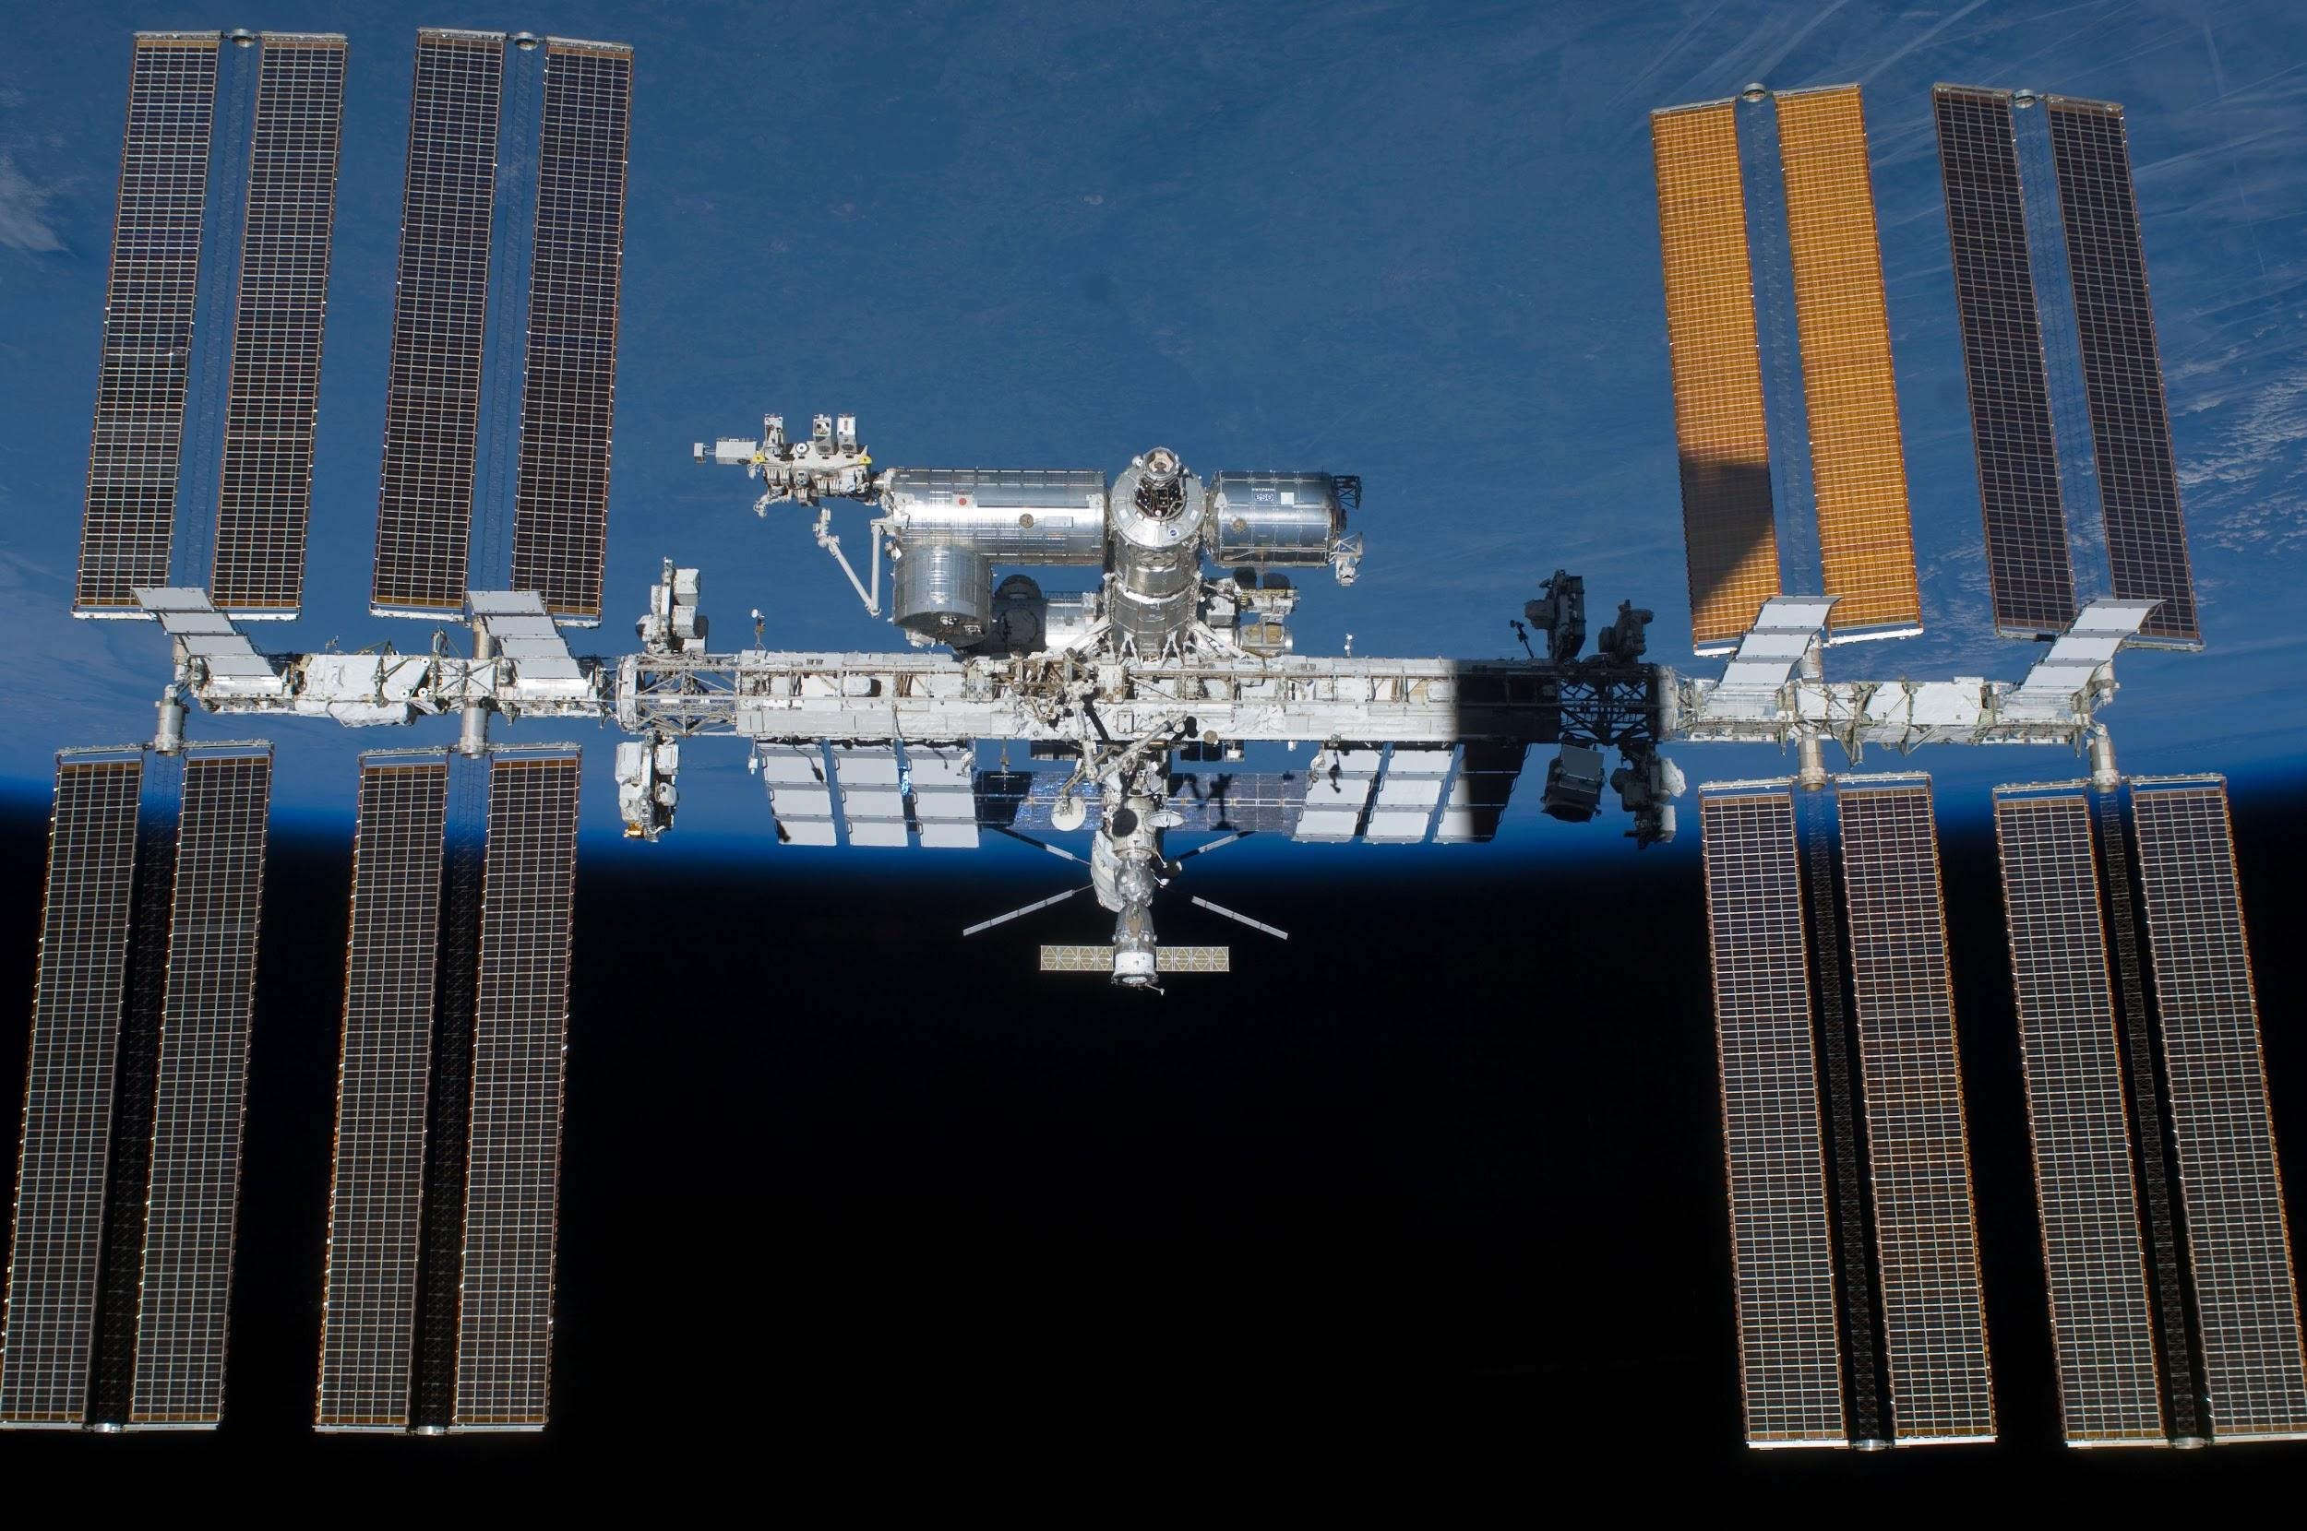
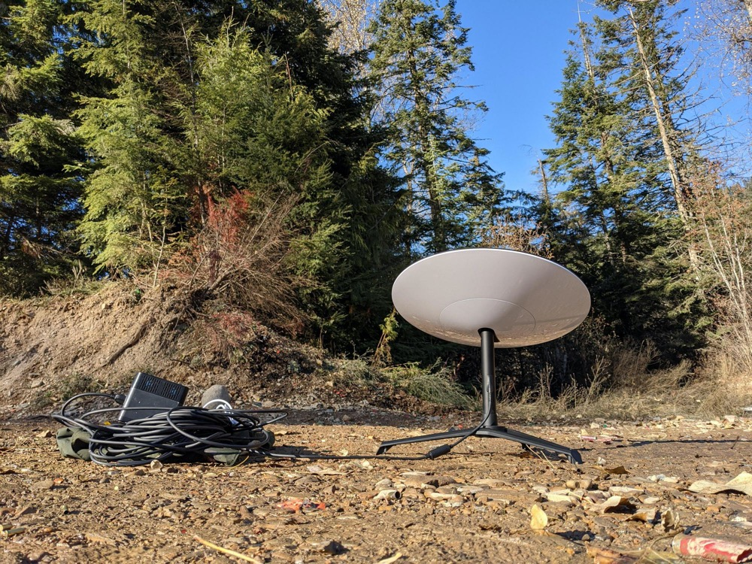
2) Who Benefits From SpaceX?
People supplying aid in developing countries
Astronauts working at the International Space Station
Companies with deployable satellite technology

Slide 5
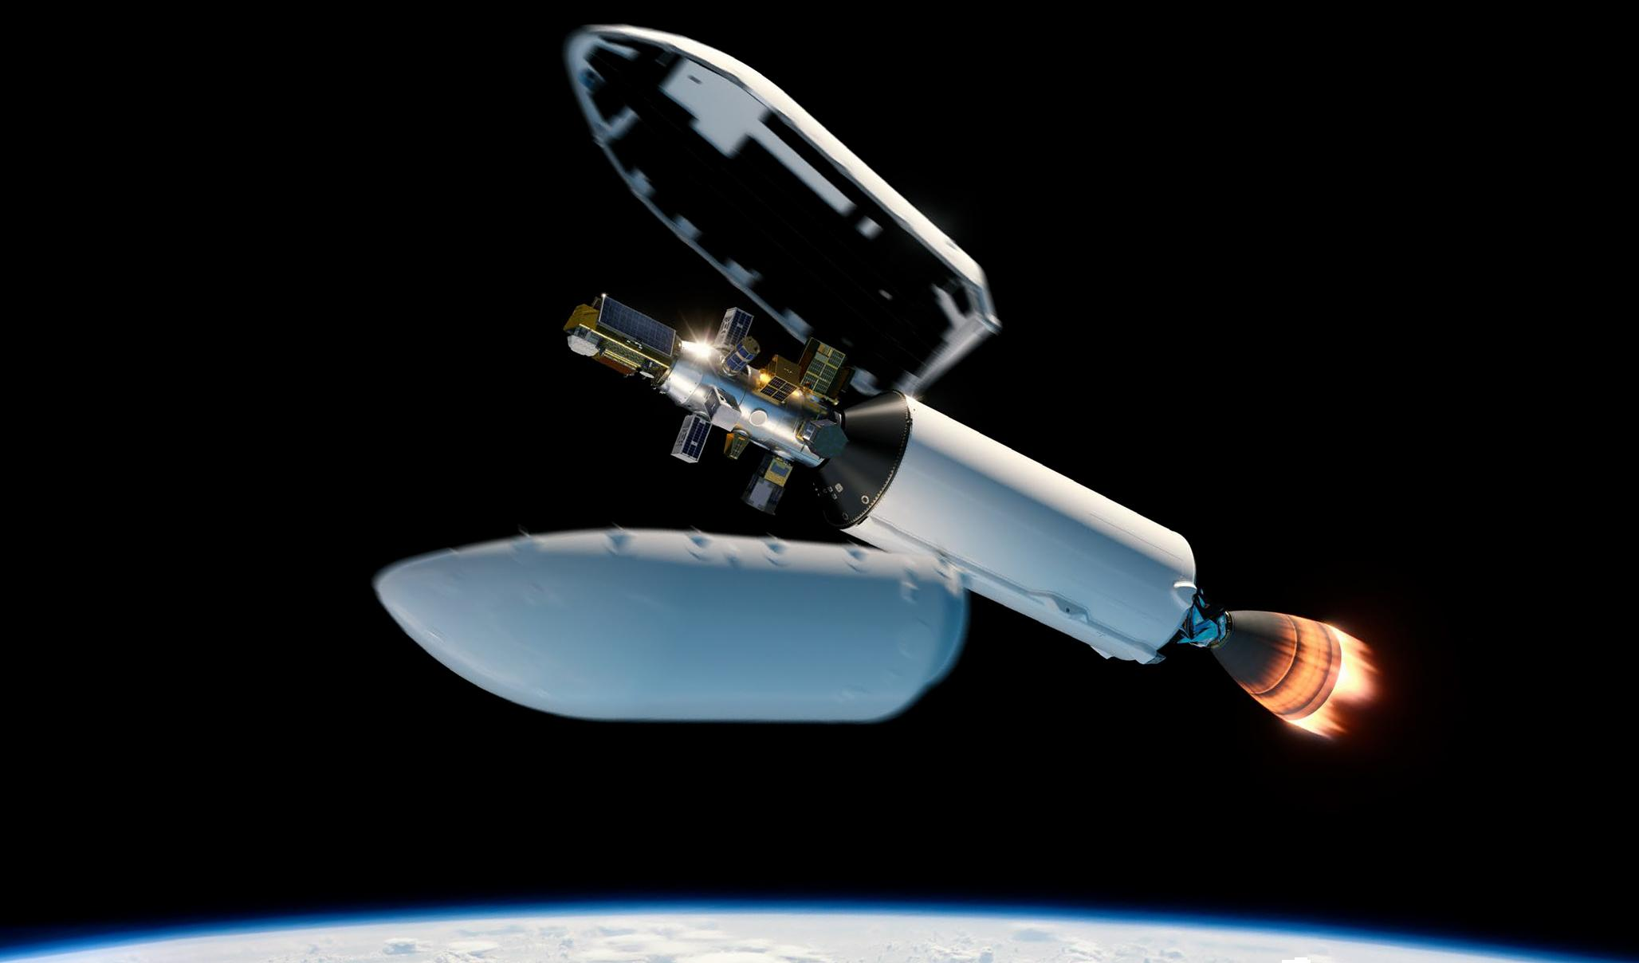
3) What Services does SpaceX provide?
StarLink
Rocket & Rocket Component Manufacturing
Rapidly Reusable Launch System
RideShare

Slide 6

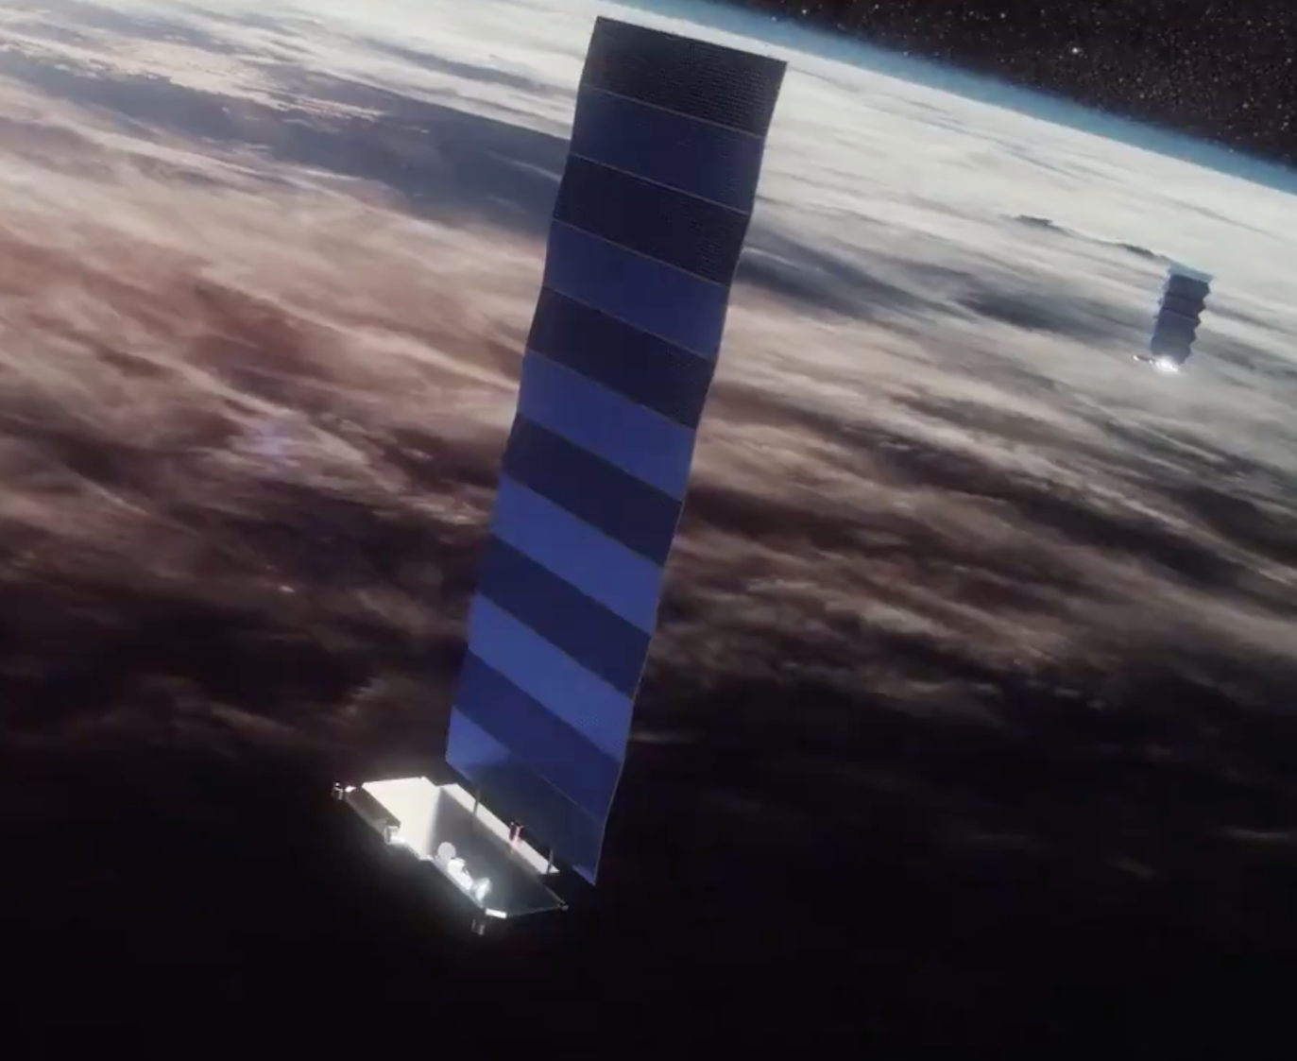
4)How does SpaceX differ from related/existing
technology?
Reusable Rocket Design
American Presence
Commercial Space-flight
Colonization of Mars

Slide 7
Thanks!
ANY QUESTIONS?
You can find me at rjs1070@wildcats.unh.edu

Slide 8
Sources : (including Pictures)
https://economictimes.indiatimes.com/news/science/historic-spacex-launch-sends-nasa-astronauts-into-space/elon-musks-spacex-makes-history/slideshow/76117262.cms
https://www.stickpng.com/img/icons-logos-emojis/tech-companies/spacex-logo
https://www.spacex.com/
https://www.forbes.com/sites/greatspeculations/2020/06/02/revisiting-spacexs-36-billion-valuation-after-its-first-manned-mission/?sh=2be5460a44fb
https://spacenews.com/wp-content/uploads/2019/05/Starlink-Screenshot.png
https://www.geekwire.com/2019/spacex-fcc-starlink-million-earth-stations/
https://www.teslarati.com/spacex-falcon-9-dedicated-rideshare-dozens-smallsats/
https://www.cnbc.com/2021/02/12/elon-musk-ceo-of-tesla-spacex-on-getting-six-hours-of-sleep.html

